Slide 1


2019 CTS Spring January 19 Meeting
Proposed Agenda
07:00 Setup, Coffee, Sign-in, Networking, Breakfast
07:55 Call to Order, Approve Agenda
08:00 Roll Call / Introduction
08:10 Section and Officers
(Chair, Vice Chairs, Sec., Treasurer)
09:00 Budget Approval
09:10 Strategic Plan/Initiatives and Leadership Opportunities
09:20 Standard Committee Reports
(STEM/YP/PACE/Conferences/Members Upgrade, Membership Development, PARP,
LM-Technical Tour)
10:00 Break
10:20 Response to Chapter chair needs as per recent survey
(1, 2, 3, 4, 5, 6, 7)*
11:00 Chapter/ affinity Group Reports*
xxxx
12:10 Lunch
13:00 Student Branch Chair Activities
14:15 Chapter Reports continued
14:40 New Business
Communication Portal / News Letter, Interactive Website,..
Students Community / CTS Projects
Motion to Adopt …..
15:00 Adjourn
1.Tips on Starting/Leaving chapter/affinity chair
2. Attracting Audience to my meeting/function
3. Budget & Control – Part A
4. Budget & Control – Part B
5. Outreach
6. Value IEEE is offering/Member Benefits
7. Preparing for Election
Notes:
Notes:

Slide 2
IEEE Central Texas Section
2019 SPRING Planning meeting
January 19, 2019
San Marcos, TX
Section: CTS Central Texas Section
Prepared by: Fawzi Behmann

Slide 3
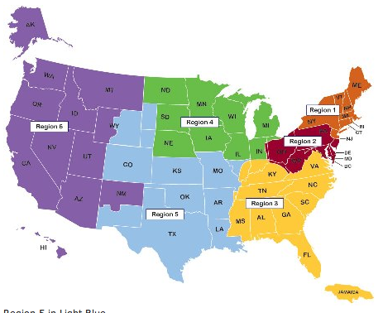
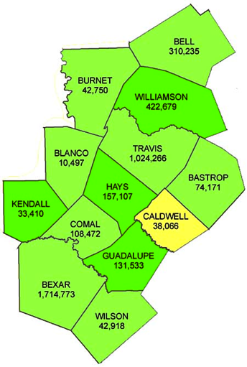
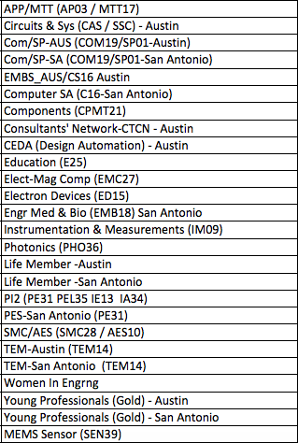
CENTRAL TEXAS SECTION (CTS) (~4,000 members)
CTS
Counties
Chapters/Affinity
CTS Officers
Standing Committees/Coordinators
Chair
Fawzi Behmann
Vice Chair – A
Fabio Gomez
Vice Chair – SA
Ehsaneh Sunny Shahhaidar
Secretary
Raymond Choo
Treasurer
Bill Martino
Past Chair
Leslie Martinich
Past Past Chairs
Kenny Rice
Strategic Plan
Policies and Procedures PARP
Awards and Recognition
Membership Development
Electronics Communications
Website
vTools/Collabratec/Social Media
Communications Portal
Conferences/Events
Section-Chapter Vitality Chair
Finance Committee
K-12/STEM Educational Activities
Students Activities
Professional Activities – PACE
Outreach Program
Humanitarian
Student Chapters
Student Branches

Slide 4
CTS Mission
For Central Texas Section to be RELEVANT to the members and community at large.
Chapter vitality: Min 3-5 meetings, relevant topics, increase attendance, audience satisfaction
Improve Communications and Training
Building communities of Interest: K-12, Student engagement, YP
CTS Initiatives: Collaboration with other consortiums/councils, special interest groups, industry, government and academia
Collaboration with other sections, regions, and societies
Notes:
Notes:

Slide 5
CTS Mission
Chapter vitality: Min 3-5 meetings, relevant topics, increase attendance, audience satisfaction
  Continue to improve on Budget preparation and reporting (quarterly) and respond to external inquiry
  Tracking inactive chapters and develop action plan
  Celebrated achievement and awarded individuals in Austin & San Antonio and section for exceptional services. Two CTS Fellows joined us.
  Initial discussion on having AI-based record management (recording, retrieval & reporting)
  New position on Chapter-Section Vitality chair
2. Improve Communications and Training
  Establish Icon for the section and outline counties. CTS: 3,939 members, with over 48 Fellows and over 428 Senior Members.
  Launch CTS newsletter and editorial column
  Chapter/Officers – Operations Training (San Antonio & Austin)
  Recorded session and slides on CTS website
  Leadership Training
  Survey and action plan to support CTS Leadership
  Gap analysis (CTS Roster, vTools, Website, …)
3. Building communities of Interest: K-12, Student engagement, YP
  Started 2 Students Outreach Community Projects at Texas State (8 students, 2 Mentors)
  Addressed UT Students & Opportunity to leverage new labs at UT-Austin
  Application for 30K Grant. Connect with Discover engineering.
  Communications Portal Discussion (Interactive website, social media, hosting discussion blogging, volunteer/Career features,..)
Notes:
Notes:

Slide 6
CTS Mission
4. CTS Initiatives: Collaboration with other consortiums/councils, special interest groups, industry, government and academia
  Himss/IHP IoT Day (March)
  SxSW Collaboration with IEEE and ACUP and ATC (March)
  Established session on Open Data & privacy issues between CoA and Malaysia PM Office on Innovation (April)
  CVD – Congressional Activities (PACE based), Follow-up engagement on Policy
  NI Week (May)
  Future Leadership Forum (July)
  IEEE Day – series of activities in Austin and San Antonio
  Dell Medical – Blockchain Healthcare Initiatives (October) – is requesting more engagement in 2019
  InnoTech – Collaboration on IEEE Day. Great exposure, great sign up (October)
  PAWR - 5G Test bed for smart connected community (Nov-Dec)
5. Collaboration with other sections, regions, and societies.
  R5 GreenTech of Smart City (April 4-6)
  R5 Meeting / Student Competition (April 6-8)
  Bid to host ComSoc – Globecom 2022
  DL Program reaching out to over 16 Lecturers in 8 cities, in 3 countries - US, Mexico, Tunisia (no cost to the section)
  Lessons learned from GreenTech (Nov-Dec)
Notes:
Notes:

Slide 7


10th Annual GreenTech
2018 IEEE International Conference of Smart City
April 4-6, 2018, Austin
http://ieeegreentech.org/
2018 GREENTECH OF SMART CITY,
AUSTIN, TEXAS
Hosted by Central Texas Section

Slide 8
  2018 Greentech Achievement
3-day multi-track rich conference program, over 270 in attendance
5 keynote speakers from government and industry
Over 24 panel and speaker sessions on diverse topical areas (over 80 speakers)
17 technical sessions (35 research papers with over 80 authors)
5 workshops
16 Exhibits
2 technical tours
Reception and Banquet
Social/networking opportunities
$100,000 Smart City Pitch Competition – Launch
Over 40 companies/institutions represented
Contracted services for Website/Mobile, Registration, Advertisement & Promotion
Resources: OC, Advisory board, MCE, Website, ADV, Volunteers
2018 GREENTECH OF SMART CITY,
AUSTIN, TEXAS

Slide 9
































  2018 IEEE GreenTech Conference OF SMART CITY
Financial Sponsors
IEEE Central Texas
IEEE Region 5
Technical Sponsors
Silver Sponsor
Affinity/Chapter Sponsors
Supporters
2018 GREENTECH OF SMART CITY,
AUSTIN, TEXAS

Slide 10


Welcome to Health Forum on
“Blockchain-Based Healthcare Initiatives”
Agenda
1:00 pm - 1:30 pm Registration and networking
1:30 pm – 4:50 pm Blockchain based Healthcare Initiatives
1:30 – 1:45 Opening Remarks:
Dell Med – Dr. Anjum Khurshid,
UT & Fellow, Max Sherman - Prof. Sherri Greenberg
IEEE Central Texas Section Chair – Fawzi Behmann
1:45 – 1:50 Kevin MacVittie, MC & Program Introduction and format
1:50 – 2:00 Joshua Konkle, Economic development work
2:00 – 3:15 Session 1
3:15 - 3:35 Networking Break
3:35 - 4:50 Session 2
4:50 pm - 5:00 pm Initiatives for future collaboration
Notes:
Notes:

Slide 11
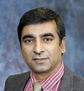
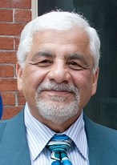

Welcome to Health Forum on
“Blockchain-Based Healthcare Initiatives”
Opening Remarks
Anjum Khurshid, MD Ph.D., Director of Data Integration, Dell Medical
Fawzi Behmann, IEEE Central Texas Section Chair, IEEE EMBS & Computer Austin Joint Chapters Chair, ACUP Board Member, Himss/IHA Planner
Sherri Greenberg, Clinical Professor | Fellow, Max Sherman Chair in State & Local Government, The University of Texas at Austin
Notes:
Notes:

Slide 12
Welcome to Health Forum on
“Blockchain-Based Healthcare Initiatives”
FEEDBACK
A giant step has taken by IEEE CTS-EMBS & Computer collaborating with Dell Medical to hold a Health Forum event on 29 October.
The theme is Blockchain Based Initiatives in Healthcare. Seven CEOs and leaders of blockchain took part in a well-attended special program held at Dell Medical.
OUTCOME
Registered: 80+ Attended: 50+
Results from Initial Traction with the attendees:
24 asked to be notified of chapter events,
15 to be enrolled in receiving CTS newsletter,
13 to receive more info about IEEE,
11 asked for further dialog,
7 ready to volunteer and
14 potential speakers.
Notes:
Notes:

Slide 13
2019 -
An Exciting Year Ahead - Objectives
Focus on Strategic direction that will drive initiatives, resource commitment, financial plan & control, and vitality to chapters and the section supported by simplified P&P.
Empower chapter leaders and CTS officers with guidelines, tips and training to efficiently run their OU and committees.
Bring about a consolidated and smart CTS Record management.
Building brand equity with Outreach Events bringing closer collaboration among industry, academia and government aimed at increase value to the community and solidify/enlarge the base.
Increase focus on student’s activities with ushering first CTS student conference.
Simplify financial planning and management (Budget plan, Expense reporting, Budget Control, Risk mitigation).
CTS vitality rewarding and recognizing efforts and accomplishments in advancing the objectives of the section.

Slide 14
2019 -
An Exciting Year Ahead: Key Initiatives
Capitalize on being RELEVANT and create initiatives with great focus on solidifying the base, creating greater awareness, traction, increase territory/membership:
Initiative 1:
Collaborate with Government, Industry and Academia and hold series of events that discusses technical trends in collaborative technologies such as 5G/6G, IoT, AI/ML, Nano-technology, cyber security and impact on building smart solutions for our communities and cities
City
Initiative 2:
Empower Students to hold 2019 Student Conference capitalizing on virtual techniques and a series of standalone fulfilled activities
Initiative 3:
Develop Communication portal for networking, blogging and technology/group discussions.

Slide 15
OUTREACH

Slide 16
OUTREACH Events
Challenge: How to create a Successful outreach event?
Look at potential need(s) that will benefit others
Brainstorm:
  Out of many areas, which areas that dive to the core and create greater value and differentiation
  Rehearse some details with others to assess the scope
    Scope-> resources, commitment , $, coordination and execution
  How? A small team look into the feasibility and initial commitment
  Practice by launching a small scale event
  Analyze what went right and what went wrong for improvement
  Incremental growth towards bigger & quality events, relationship that last

Slide 17
OUTREACH Events – GET Started
Examples
Start with High School:
  Help in School council --
  Volunteer at Discover Engineering
    > this would form basis for event that you lead and engage schools/students
IEEE Humanitarian Projects
  Student various project on IEEE website
  Engage in one of them or propose a new one
Educational workshop – special focused event
  Engage with chapters that have a plan in this area
Be Part of CTS Outreach program

Slide 18
CTS Leadership
CTS
Chapters/Affinity
Committees
Chair
Fawzi Behmann
Vice Chair – A
Fabio Gomez
Vice Chair – SA
Ehsaneh Sunny Shahhaidar
Secretary
Raymond Choo
Treasurer
Bill Martino
Past Chair
Leslie Martinich
Past Past Chairs
Kenny Rice
Strategic Plan
Policies and Procedures PARP
Awards and Recognition
Membership Development
Electronics Communications
Website
vTools
Communications Portal
Conferences/Events
Section-Chapter Vitality Chair
Finance
K-12 Educational Activities
University Activities
Professional Activities – PACE
Outreach Program
Humanitarian
Coordinators
Analog
Mid-month reminder
Web Master
Communications Portal
Public Relations

